Slide 1
Default prediction model
Bene
Shinan

Slide 2

Default Risk

Slide 3
Input briefing

Slide 4
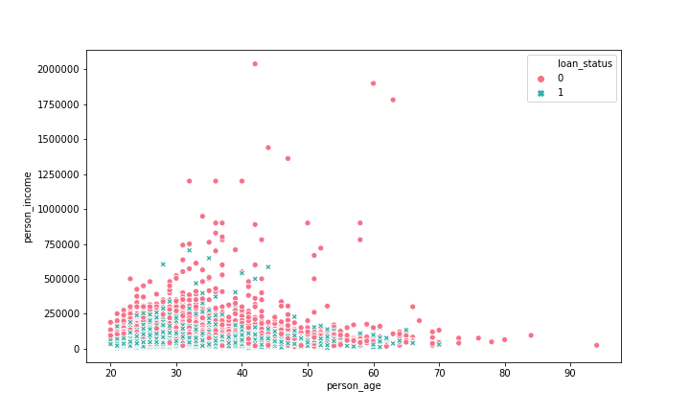
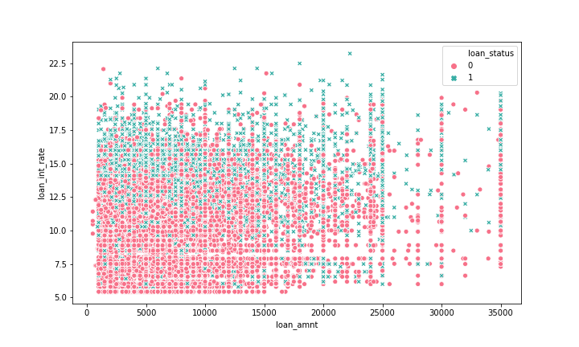
Prelimiary Data Analysis
0 = non default ; 1 = default
Default (green dots) gathered lower income
0 = non default ; 1 = default
Non_default rate (red dots) gathered at lower interest rate

Slide 5
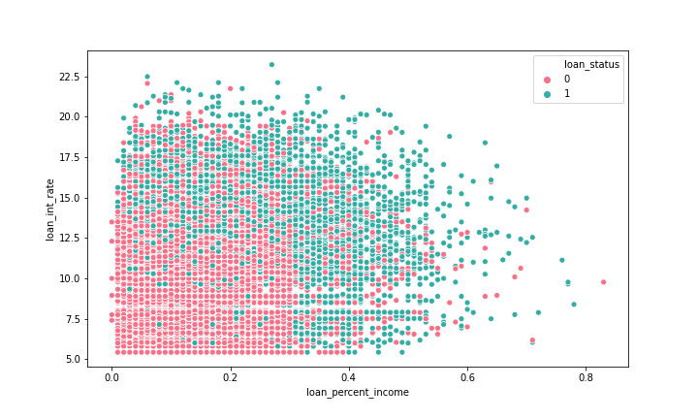
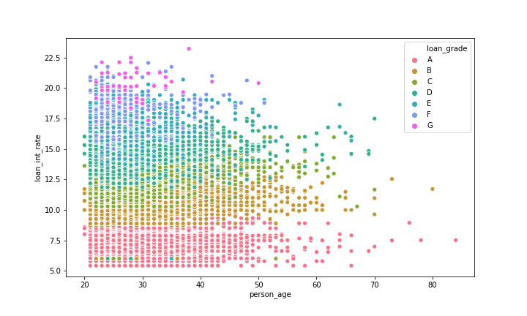
Prelimiary Data Analysis
0 = non default ; 1 = default
Non_default (red dots) gathered at lower Non_default (red dots) gathered at lower % loan/income
0 = non default ; 1 = default
The higher the insterest (y-axis) , the lower the loan grade

Slide 6
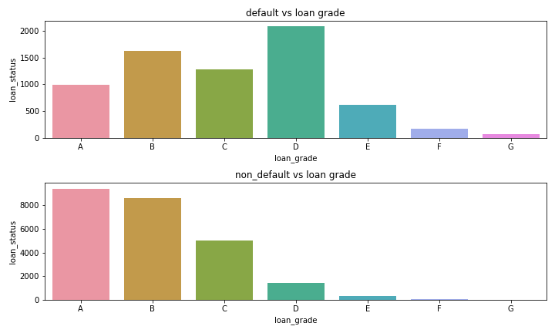
Defaulted loan mainly from D level grade
Non_defaulted loan mainly from A level grade

Slide 7
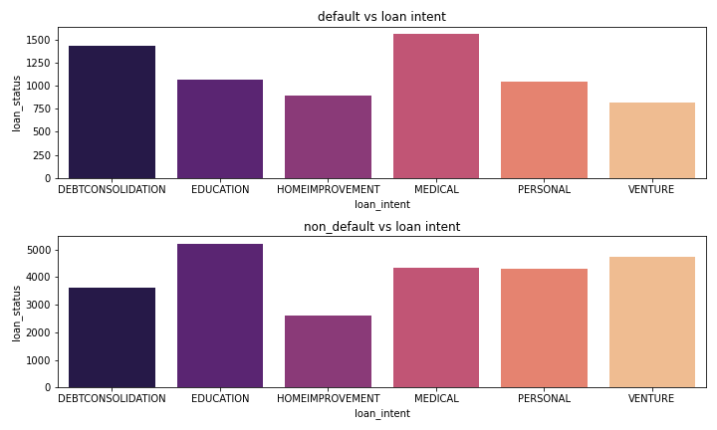
Defaulted loan mainly from debt consolidation and medical
Non_defaulted loan mainly from education and venture
* Consumers can use debt consolidation as a tool to deal with student loan debt, credit card debt, and other liabilities.

Slide 8
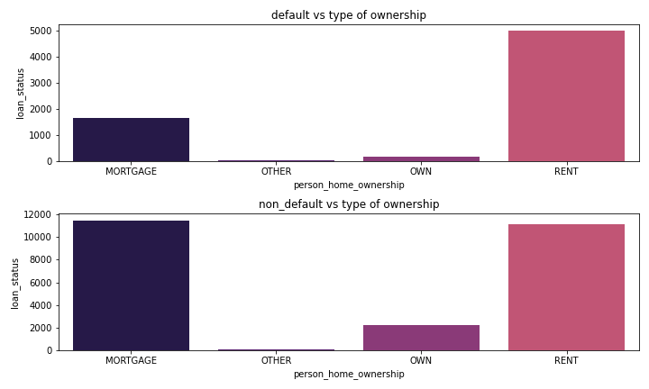
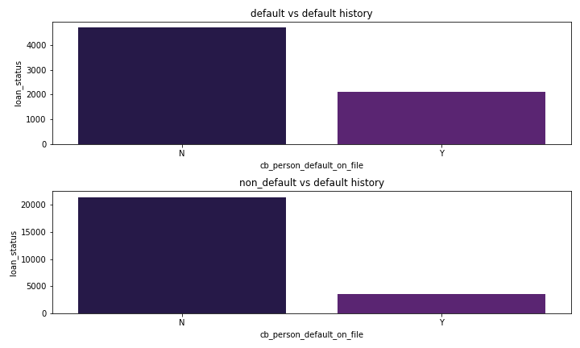
Default mainly from rent home
Non_default mainly from mortgage category which could mean that the people who decided to buy a home, they have a better financial situation.
The people who have bad credit history, they might default again

Slide 9
Variable | coef | std err | z | P>|z| | [0.025 | 0.975]
const | -3.5559 | 0.141 | -25.281 | 0.000 | -3.832 | -3.28
person_income | -0.000011 | 0.000000712 | -15.359 | 0.000 | -0.000012 | -0.00001
person_emp_length | -0.0198 | 0.005 | -3.9 | 0.000 | -0.03 | -0.01
loan_int_rate | 0.0497 | 0.014 | 3.619 | 0.000 | 0.023 | 0.077
loan_percent_income | 8.5544 | 0.183 | 46.766 | 0.000 | 8.196 | 8.913
cb_person_cred_hist_length | -0.0045 | 0.005 | -0.981 | 0.327 | -0.013 | 0.004
OTHER | 0.7228 | 0.29 | 2.495 | 0.013 | 0.155 | 1.291
OWN | -1.5205 | 0.109 | -13.939 | 0.000 | -1.734 | -1.307
RENT | 0.8948 | 0.043 | 20.84 | 0.000 | 0.811 | 0.979
EDUCATION | -0.8725 | 0.061 | -14.396 | 0.000 | -0.991 | -0.754
HOMEIMPROVEMENT | 0.0067 | 0.067 | 0.099 | 0.921 | -0.125 | 0.139
MEDICAL | -0.1771 | 0.057 | -3.107 | 0.002 | -0.289 | -0.065
PERSONAL | -0.6379 | 0.062 | -10.3 | 0.000 | -0.759 | -0.517
VENTURE | -1.0997 | 0.065 | -16.803 | 0.000 | -1.228 | -0.971
B | 0.2443 | 0.068 | 3.605 | 0.000 | 0.111 | 0.377
C | 0.525 | 0.096 | 5.474 | 0.000 | 0.337 | 0.713
D | 2.5725 | 0.118 | 21.784 | 0.000 | 2.341 | 2.804
E | 2.7083 | 0.153 | 17.656 | 0.000 | 2.408 | 3.009
F | 3.1665 | 0.231 | 13.726 | 0.000 | 2.714 | 3.619
G | 6.9556 | 1.107 | 6.285 | 0.000 | 4.787 | 9.125
Y | -0.0086 | 0.053 | -0.163 | 0.871 | -0.112 | 0.095

